Slide 1


(BDA5)
TATIANA SHUPIK
HAPPY
INSURANCE
Presentation
October 2024

Slide 2

Table of
CONTENTS
DEFINITION
3
STAR SCHEME
4
HAPPY INSURANCE PROJECT
TIMELINE TEMPLATE
5
PROJECT TIMELINE
6
PRODUCTS
7
PRODUCTS (WHAT IF )
8
SALES TRENDS BT DIVISION
9
CUSTOMERS
10
CUSTOMERS ANALYSIS
11
COUNTRY
12
REGION
13
SEGMENTS
14
15
REVENUE AND QUANTITY GROWTH
CHALLENGES
16

Slide 3

DEFINITION
• For purpose of the analyses, it was used the original geographical definition (GEO) without consideration for grouping countries accounting to income or similar culture.
• The data is shown in absolute terms and lacks a per capital basis and makes it not possible to properly compare countries with different population sizes, therefore only regional comparison seemed adequate.
HAPPY INSURANCE PROJECT

Slide 4

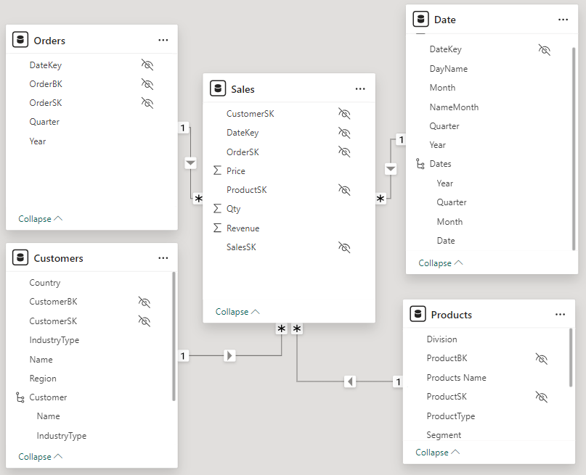
STAR SCHEME

Slide 5

Timeline Template
of the Project
1
2
3
4
5
Obtaining the
relevant data
from one or
multiple sources.
In this case, CSV file and SQL DB.
Build ETL process
using M-Language
on Power Query,
transformation
databases (DIM & Fact Table) and
building a Star
Schema.
Creation of measures on Power Pivot & BI, adapting table names and finalizing tabular
model to easily attend business necessities to
users.
Defining which
data we wish to
present to users,
create measures
(Dax Language) and start the visual creation.
Final details on reports and visuals on both Power Bi and Power Pivot.

Slide 6

Project
TIMELINE
1 WEEK
2 WEEK
3 WEEK
4 WEEK
5 WEEK
PROCESS ONE
PROCESS TWO
PROCESS THREE
PROCESS FOUR
PROCESS FIVE
HAPPY INSURANCE PROJECT

Slide 7

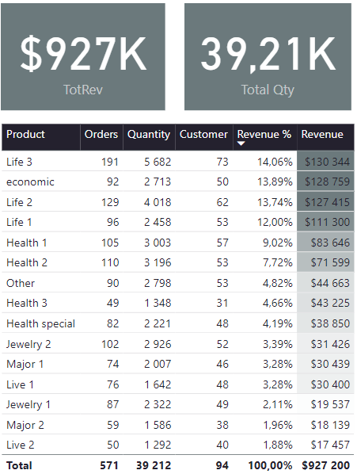
PRODUCTS
Top Performers: Life 3, Economic, and Life 2 are the top three revenue generators, each contributing over 13% of total revenue.
Low Performers: Live 2, Major 2, and Jewelry 1 are the lowest revenue contributors, each accounting for less than 2% of total revenue.
1
RESEARCH
CONCLUSIONS
2
REVENUE ANALYSIS
For products like Health 2, which has high quantity but lower revenue percentage, review pricing strategies to maximize profitability.
Consider product improvements(Live 2, Major 2, and Jewelry 1 are underperforming), pricing adjustments, or increased marketing efforts.
3
IMPROVE LOW PERFORMERS
Consider phasing out or revamping consistently underperforming products if improvements don't yield results.
4
PRODUCT LINE EVALUATION
HAPPY INSURANCE PROJECT

Slide 8
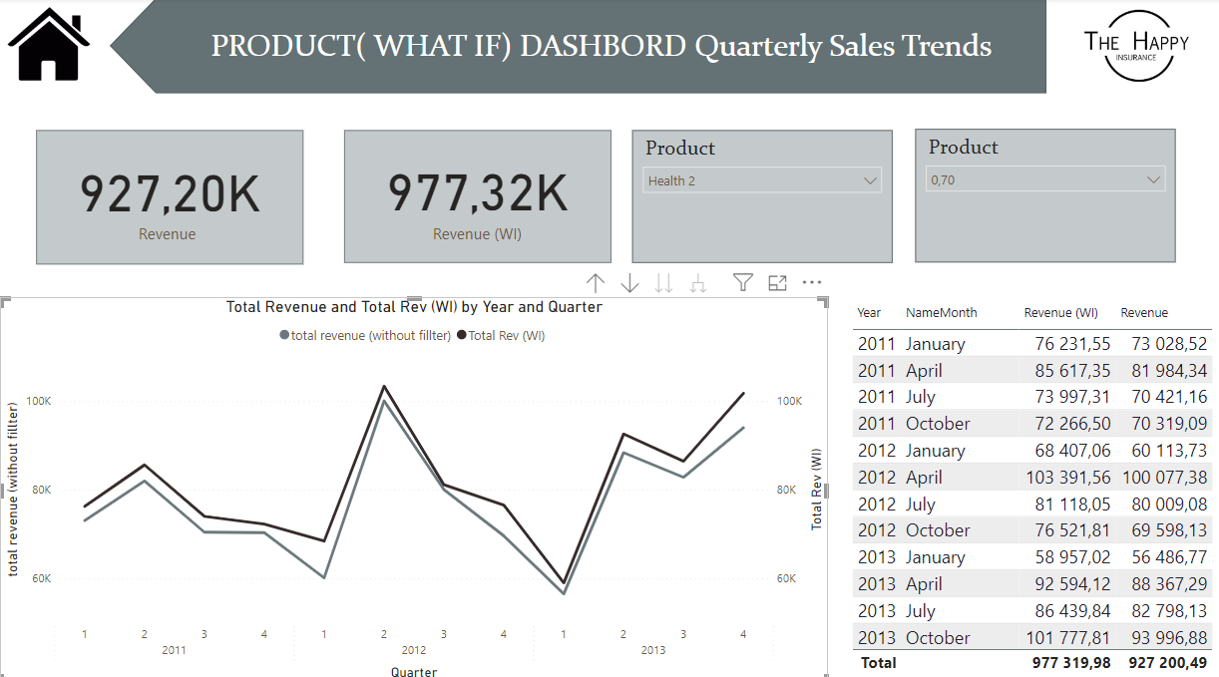
Products
This report shows how changes in product prices affect the total income.
Quarterly Variations:
The graph indicates significant quarter-to-quarter changes, which could be due to seasonal factors, market conditions, or strategic pricing decisions.
This report shows how changes in product prices affet the total income.

Slide 9

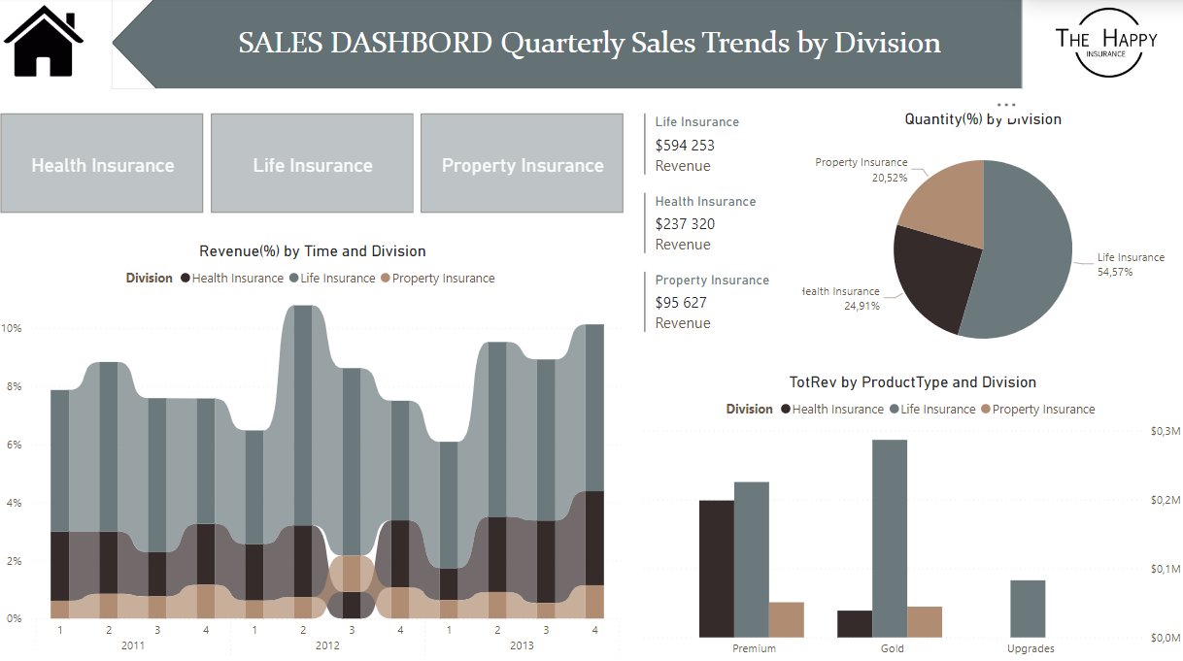
SALES TRENDS BY DIVISION
On all three regions Life Insurance takes the lead, closely followed by Health Insurance (in the Premium Segment). In the Gold Segment, life insurance is mainly provided. Property Insurance holds a miniscule relevance in the overall revenue composition of the company.

Slide 10
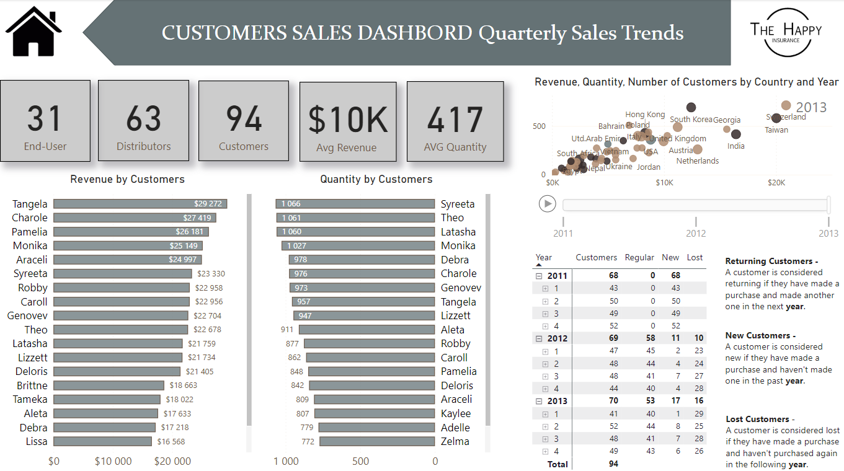
Returning-New-Lost Customers Analysis
The report allows to see returning customers, new customers and lost customers according to selected
years at the click of a button. In addition, you can see customer revenues according to date filtering.

Slide 11


Revenue:
Average revenue per customer is $10K, with top performers like Tangela and Charole generating over $27K each.
Customer Retention:
There's a concerning trend of losing customers each year
(10 in 2012, 16 in 2013 so far).
New Customer Acquisition:
The company is acquiring new customers
(11 in 2012, 17 in 2013 so far), its enough to offset losses.
Year-over-Year Growth:
Total customers increased from 68 in 2011 to 70 in 2013, showing slow growth.
Leverage Top Performers:
Analyze what makes customers like Tangela and Charole successful. Use these insights to help other customers increase their purchases.
Geographic Expansion:
For lower-performing countries, assess if there are untapped opportunities or if resources should be reallocated.
Customer Segmentation:
Develop targeted strategies for end - users vs distributors, as their needs and buying patterns likely differ.
CONCLUSIONS
and RECOMMENDATIONS
CUSTOMERS

Slide 12

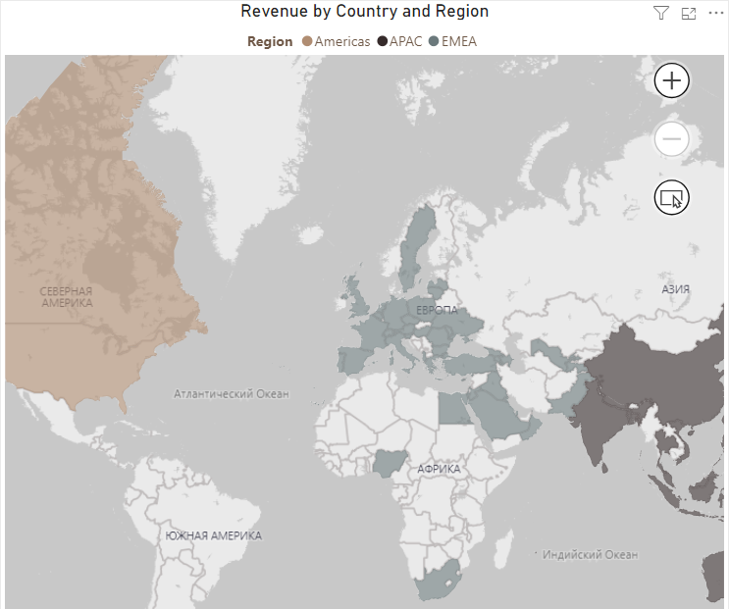
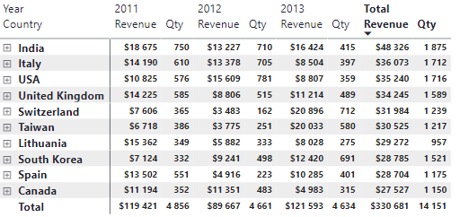
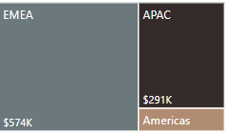
COUNTRY
Regional Performance:
EMEA is the top-performing region with $574K in sales, followed by APAC ($291K) and Americas.
Top Markets:
India, Italy, and the USA are the top 3 revenue-generating countries over the 3-year period.
Growth Trends:
Some countries show significant growth (e.g., Switzerland), while others decline (e.g., India, USA).
Market Diversity:
The company operates in at least 19 different countries across multiple regions.
RECOMMENDATIONS
Expand in EMEA:
Given EMEA's strong performance, consider expanding operations or marketing efforts in this region.
Investigate Low-Performing Markets: Evaluate the viability of continuing operations in consistently low -performing countries like Guam, Cyprus and Tajikistan.

Slide 13

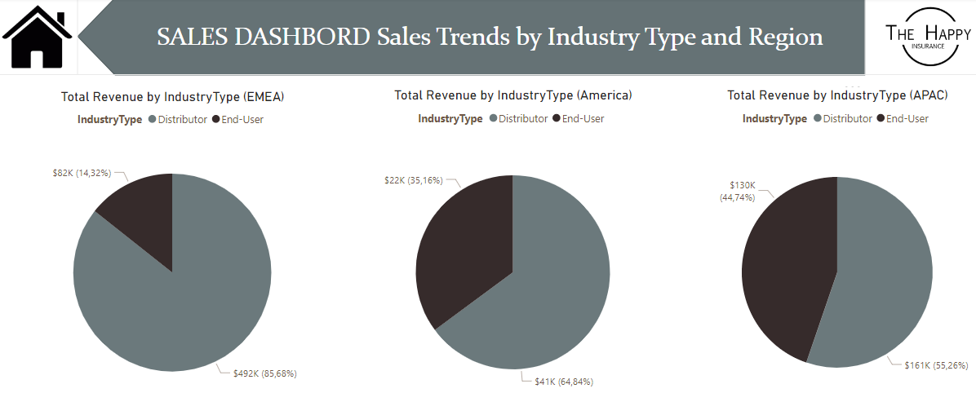
Observation for Industry Type by GEO and:
SOLUTIONS
APAC and Americas hold a very similar division structure, with End Users having an overwhelming participation (of over 55%). The situation is absolutely reversed when analyzing EMEA, where 85% of customers are distributors.
EMEA is a very diverse region involving Europe, the Middle
East and Africa. It is possible that less developed economies with higher degrees of bureaucracy in the Middle East and Africa are more suitable for dealing with large distributors. If so, that is critical information that should be considered for strategic decisions within the company.

Slide 14
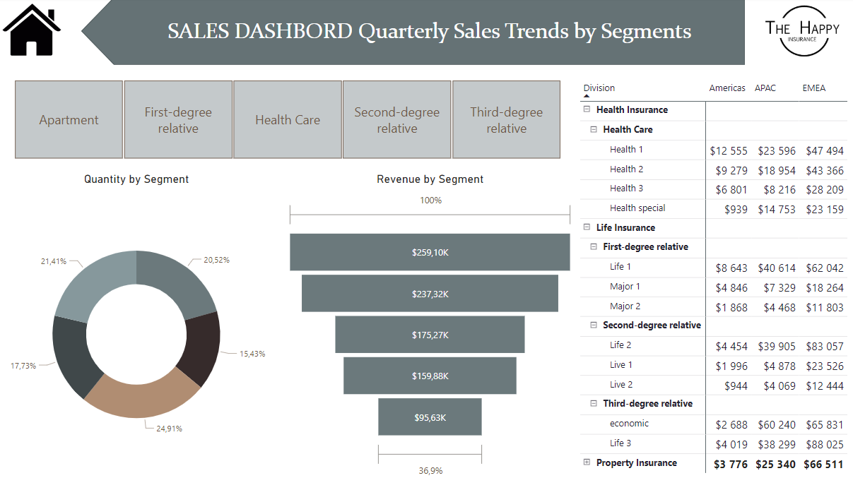
SEGMENTS
Happy Insurance Project
What would happen on the variation of Sales Revenue
by Division Name:
Since Property Insurance does not hold a sizable portion of the overall
revenue composition, even doubling its revenue would not create a noticeable variation on the performance of the company. To put it in
perspective, it would be preferable to have Happy Insurance increasing 10% of its revenue in Health Insurance than increasing 100% of its revenue in Property Insurance.
HAPPY ISURANCE PROJECT

Slide 15
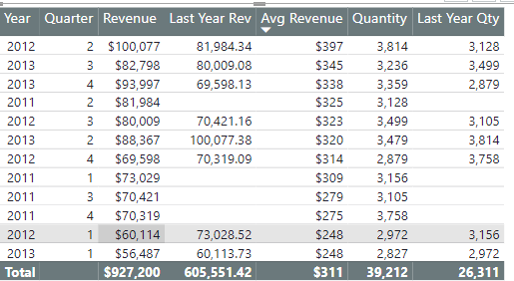
REVENUE AND QUANTITY
GROWTH
CONCLUSIONS
Revenue Trend:
There's an overall upward trend in revenue from 2011 to 2013, despite some fluctuations between quarters.
Quarterly Patterns:
Q2 and Q3 tend to have higher revenues compared to Q1 and Q4 across the years.
Year-over-Year Growth:
2013 shows improvement over 2012 in most quarters, indicating positive growth.
Average Revenue:
The overall average revenue per unit is $311, which has increased over time.
Quantity Sold:
There are fluctuations in quantity sold, but no clear upward or downward trend is evident.

Slide 16

Challenges
1
2
Of the project
Define who is a new customer, who is a returning customer and who is a lost customer, apply the logic and present correct data.
Overcome the fact that measure works according to the context when you want to show the sum
of the field in a certain visual.
Finally, it is recommended to no longer aggregate Europe, the Middle East and Africa into the same regional area since they are very heterogeneous, and relevant information may be lost when combining such different
realities.
3
4
Check how the measures and other data objects are reflected in the tables and whether they
present correct data.
Showing analyzed data in visual or graphical form to improve growth and increase business
profitability.

Slide 17

THANK
YOU
for watching

